Slide 1
Sustainability in quality improvement
Dr. Frances Mortimer & Dr. Stuart D’Arch Smith
Medical Director & Education Fellow, Centre for Sustainable Healthcare

Slide 2
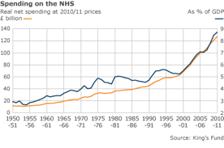

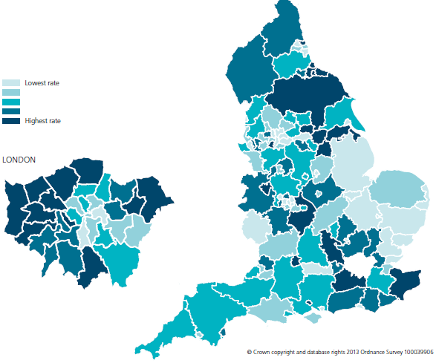
Protecting the health service for current and future generations
Will the NHS still be here in 2025 / 2035?
ECONOMIC CHALLENGES
Rising demand for hc
Static finances
‘Payment by activity’
Trade agreements
ENVIRONMENTAL CHALLENGES
Climate resilience
Carbon reduction
Pollution, finite resources
SOCIAL CHALLENGES
Declining family support
Safety / quality concerns
Staffing / morale

Slide 3

Protecting health for current and future generations
Does healthcare activity build health – or undermine it?
ECONOMIC CHALLENGES
Funding priorities – healthcare or health?
Impact of poor health on economy
Limits to GDP growth
ENVIRONMENTAL CHALLENGES
Climate breakdown & biodiversity loss:
extreme weather, famine, conflict
Pollution - air, land and water
Finite resources
SOCIAL CHALLENGES
Loss of social capital – communities, families
Poverty and inequality
Labour standards
Supply chain workers paid less than US$1 per day, no health and safety, many are children
Air pollution kills 40,000 in UK each year.
NHS is responsible for 5% of all journeys

Slide 4
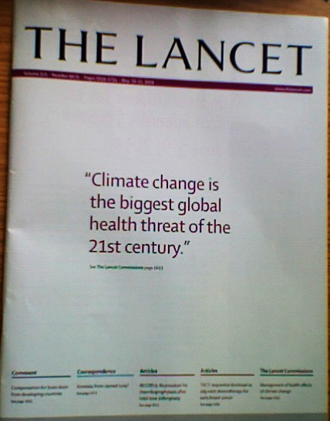
Healthcare emits:
10% GHGs in the US¹, 7% GHGs in Australia², and 5% GHGs in England³
“Right now we are facing a manmade disaster of global scale, our greatest threat in thousands of years: climate change. If we don’t take action, the collapse of our civilisations and the extinction of much of the natural world is on the horizon.”
Notes:
¹Eckelman M J, Sherman J (2016). Environmental Impacts of the U.S. Health Care System and Effects on Public Health. PLoS ONE 11(6): e0157014
² Malik A, Lenzen M, McAlister S, McGain F. The carbon footprint of Australian health care. Lancet Planetary Health 2(1): e27-35
³ Sustainable Development Unit. (2016). Carbon Footprint update for the NHS in England.

Slide 5
REFERENCES for previous slide
¹Eckelman M J, Sherman J (2016). Environmental Impacts of the U.S. Health Care System and Effects on Public Health. PLoS ONE 11(6): e0157014
² Malik A, Lenzen M, McAlister S, McGain F. The carbon footprint of Australian health care. Lancet Planetary Health 2(1): e27-35
³ Sustainable Development Unit. (2016). Carbon Footprint update for the NHS in England.

Slide 6

“Our vision of sustainable health and care: A sustainable health and care system works within the available environmental and social resources protecting and improving health now and for future generations.”
Notes:
A definition – from the Sustainable Development Strategy for the NHS & Social Care

Slide 7
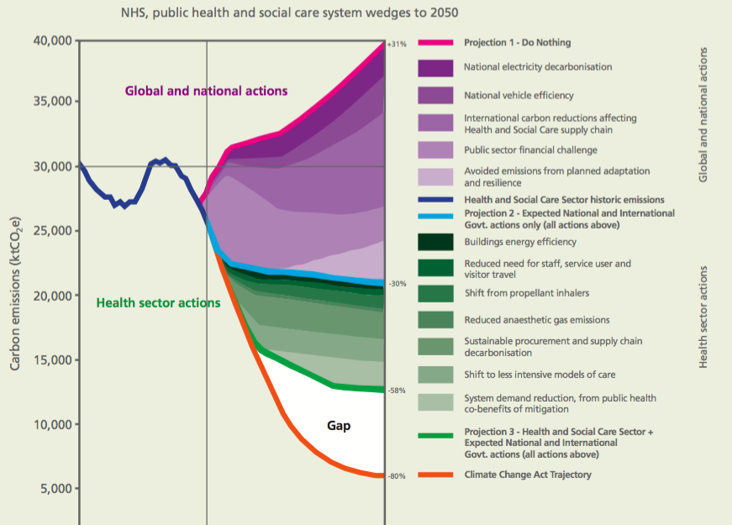

How will 80% carbon reduction be achieved?
Require clinical leadership
Notes:
Changes to clinical systems needed…

Slide 8
Clinical innovation
Senior leadership
Patient outcomes
Patient experience
Sustainability
Estates and facilities
Energy / carbon / cost
waste, travel
Secondary
Core mission

Slide 9
What if… sustainability became a mainstream part of quality improvement?

Slide 10
Sustainability as a domain of quality
Timely
Efficient
Safe
Effective
Patient Centred
Equitable
Sustainable
Dr Donal O’Donoghue
National Clinical Director for
Kidney Care 2007-13
See also: Atkinson, S. et al. Defining Quality and Quality Improvement. Clin Med vol. 10, no. 6 537-539 (2010)
Notes:
“Policy goal: Placing sustainability at the heart of NHS decision-making”
Leading for Quality - the Foundation for Healthcare over the Next Decade. The Royal College of Physicians. (2010)
“healthcare should be considered not only in terms of what can be delivered to an individual today, but also to the population in general and the patients of the future.”
Atkinson et al (2010)

Slide 11
Sustainable clinical practice: principles
Secondary drivers
Reduce carbon without reducing health
Reduce activity
Prevention
Patient empowerment
Reduce carbon intensity
Low carbon alternatives
Lean pathways
Sustainable estates
Primary driver
Outcome needed
Primary driver
Mortimer-F. The Sustainable Physician
Clinical Medicine 2010, Vol 10, No 2: 110–11
Notes:
The Centre for Sustainable Healthcare 4 principles of sustainable clinical practice.

Slide 12
Sustainable clinical practice: principles
Secondary drivers
Reduce carbon without reducing health
Reduce activity
Prevention
Patient empowerment
Reduce carbon intensity
Low carbon alternatives
Lean pathways
Sustainable estates
e.g. warm, pain-free patients post-op
Primary driver
e.g. pre-habilitation
Outcome needed
e.g. streamlined pre-op assessment
Primary driver
Mortimer-F. The Sustainable Physician
Clinical Medicine 2010, Vol 10, No 2: 110–11

Slide 13
Sustainable clinical practice: principles
Secondary drivers
Reduce carbon without reducing health
Reduce activity
Prevention
Patient empowerment
Reduce carbon intensity
Low carbon alternatives
Lean pathways
Operational resource use
e.g. warm, pain-free patients post-op
Primary driver
e.g. pre-habilitation
Outcome needed
e.g. streamlined pre-op assessment
Primary driver
e.g. sevoflurane vs desflurane (1:20)
e.g. capture and resupply of volatiles
Mortimer-F. The Sustainable Physician
Clinical Medicine 2010, Vol 10, No 2: 110–11

Slide 14
How could sustainability become a mainstream part of quality improvement?
The SusQI framework

Slide 15
Mortimer F, Isherwood J, Wilkinson A, Vaux E. Sustainability in quality improvement: redefining value. Future Healthcare Journal, 2018 Vol.5(2):88-93

Slide 17
Studying the System: Seven Capitals Matrix
Financial :
Infrastructure:
Natural:
Patient:
Employee:
Staff networks:
Community:
Notes:
The Seven Capitals Matrix is a holistic way of identifying the resources available to the NHS for delivering health improvement.
Matrix encompasses all of the resources available for driving health improvement, including
both public health and clinical domains,
resources outside direct NHS control as well as those within it,
and patients’ role in maintaining their health and contributing to their care.
Motivated and skilled staff

Slide 18
Studying the System: Seven Capitals Matrix
Financial :
Infrastructure:
Natural: clean air, fertile soil, water availability, pollination, stable climate, green space and raw materials for healthcare consumables, e.g. metals, chemicals, rubber, timber, fossil fuels, food and biomaterials
Patient:
Employee:
Staff networks:
Community:
Notes:
The Seven Capitals Matrix is a holistic way of identifying the resources available to the NHS for delivering health improvement.
Matrix encompasses all of the resources available for driving health improvement, including
both public health and clinical domains,
resources outside direct NHS control as well as those within it,
and patients’ role in maintaining their health and contributing to their care.
Motivated and skilled staff

Slide 19
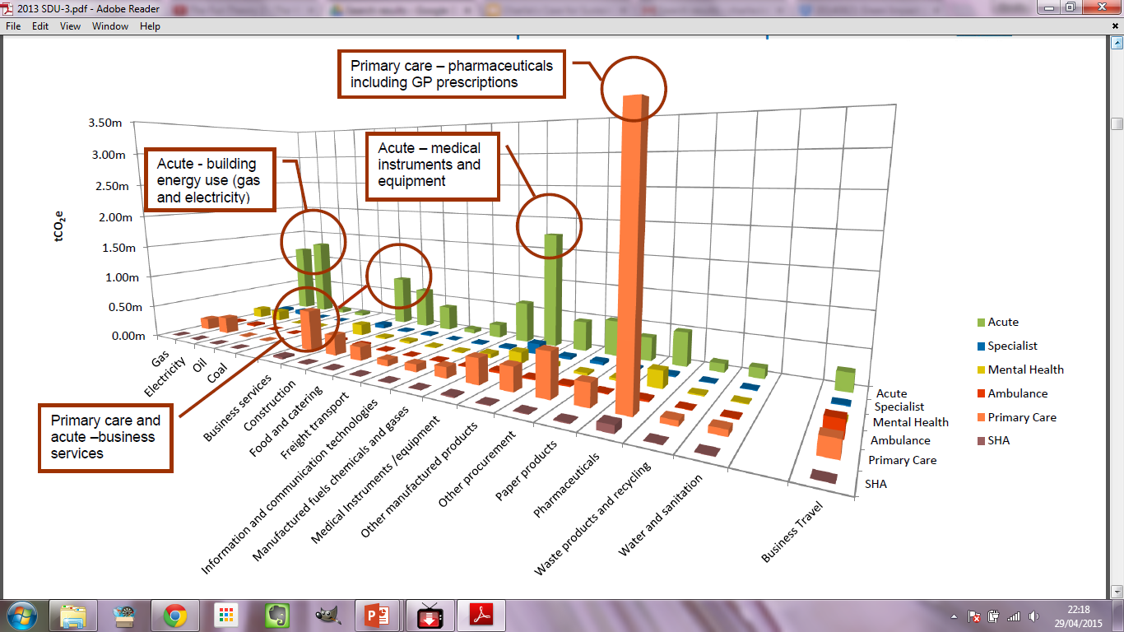
Carbon hotspots
Notes:
Knowing where the greatest environmental impacts arise can give a new perspective – and might influence your choice of QI project

Slide 20
Studying the System: Seven Capitals Matrix
Financial :
Infrastructure:
Natural:
Patient:
Employee:
Staff networks:
Community:
Notes:
The Seven Capitals Matrix is a holistic way of identifying the resources available to the NHS for delivering health improvement.
Matrix encompasses all of the resources available for driving health improvement, including
both public health and clinical domains,
resources outside direct NHS control as well as those within it,
and patients’ role in maintaining their health and contributing to their care.
Motivated and skilled staff

Slide 21
Financial:
Infrastructure:
Natural:
Patient: engaged, goodwill, feels responsible & empowered to look after own health, contribute to treatment, self-monitor, and access healthcare, navigate the healthcare system.
Employee: energy, goodwill, commitment, professionalism, better collaborations between specialities, awareness of support for staff and patients, shared decision making with engaged patients.
Staff networks: formal and informal connections to support effective healthcare delivery (including staff support & training), better info sharing with patients, sharing best practice.
Community: support networks that underpin healthy independent living, family (including dependents), local & distant (labour markets).
Notes:
The Seven Capitals Matrix is a holistic way of identifying the resources available to the NHS for delivering health improvement.
Matrix encompasses all of the resources available for driving health improvement, including
both public health and clinical domains,
resources outside direct NHS control as well as those within it,
and patients’ role in maintaining their health and contributing to their care.
Motivated and skilled staff

Slide 22
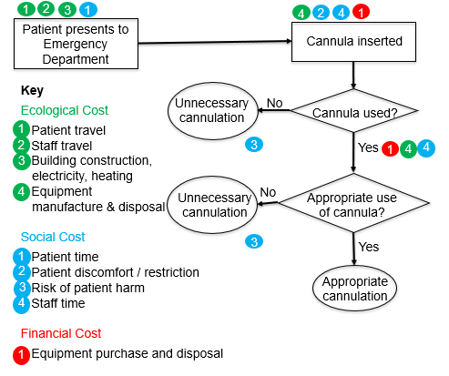
Understanding env/soc/£ resources: process map

Slide 24
Sustainable clinical practice: principles
Secondary drivers
Reduce carbon without reducing health
Reduce activity
Prevention
Patient empowerment
Reduce carbon intensity
Low carbon alternatives
Lean pathways
Operational resource use
Primary driver
Outcome needed
Primary driver
Mortimer-F. The Sustainable Physician
Clinical Medicine 2010, Vol 10, No 2: 110–11

Slide 25
A trainee project that you have supervised…

Slide 26
Your service - sustainable clinical practice
Principle | Opportunities?
1. Prevention
2. Patient empowerment and self care
3. Lean systems
4. Low carbon alternatives
Notes:
Encourage the team to brainstorm ideas relevant to their practice – capture outputs on a flip chart

Slide 27
Your service – overuse/underuse
Type of waste | Opportunities?
Overuse of low value interventions
Underuse of high value interventions
Notes:
Encourage the team to brainstorm ideas relevant to their practice – capture outputs on a flip chart

Slide 29
Measuring environmental costs - example
A primary care team noticed that some patients who were referred for hip and knee replacements were being referred back to the GP surgery after pre-operative assessment at the local hospital. This was because parameters, such as blood pressure, were either outside the target range or were not communicated properly in the referral information. An audit revealed that 1 in 6 patients looped through the system – 10/ year.
Activity | Outcome | £’s | CO₂e | Social
Extra GP consult | [delay to surgery] | £45¹ | 18 kg² | Patient & carer time/ stress
Extra Hospital consult | [delay to surgery] | £112¹ | 23 kg² | Patient & carer time/ stress (parking…)
Total (for 10 loops) |  | £1570 | 410 kg
Unit Costs of Health and Care, PSSRU, December 2015. Available at: http://www.pssru.ac.uk/project-pages/unit-costs/2015/index.php
Carbon Hotspots update for the health and care sector in England 2015, Sustainable Development Unit, January 2016.
Charlie Kenward, Severn GP ST3 Sustainability Scholar 2014-15

Slide 30
Your service – operational resource use
Resource use | Opportunities?
Energy
Travel (staff, patients)
Medical supplies
Non-medical supplies
Water
Waste
Notes:
Encourage the team to brainstorm ideas relevant to their practice – capture outputs on a flip chart

Slide 31
Scanning for social impacts
 | Patients | Carers | Community | Supply chain | Staff
Housing
Poverty
Health
Education
Employment
Safety/security
Satisfaction
Participation
Social gradient

Slide 32
Social Impacts – identifying measures
Group affected | Impact area | Measure
e.g. carers | employment | % in employment / time off work

Slide 33

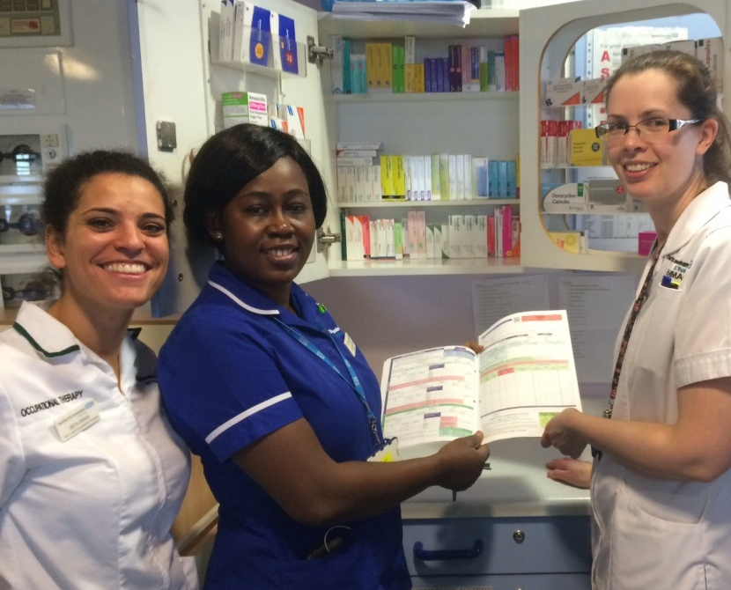
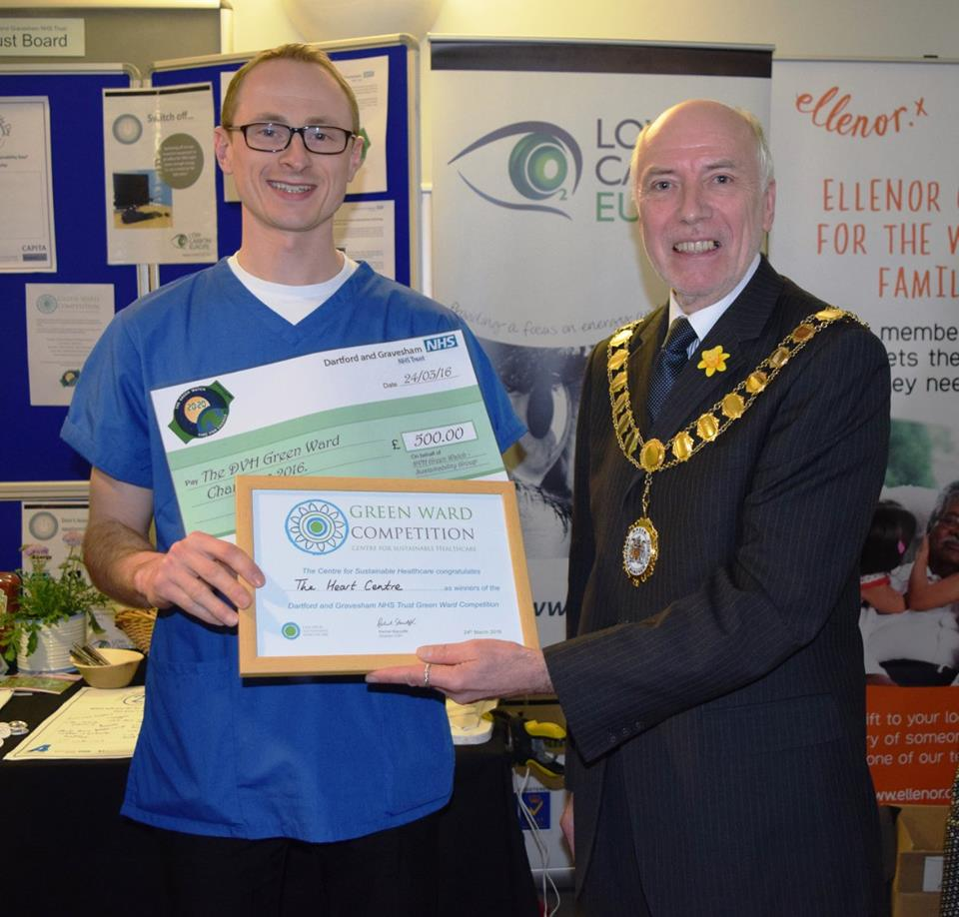
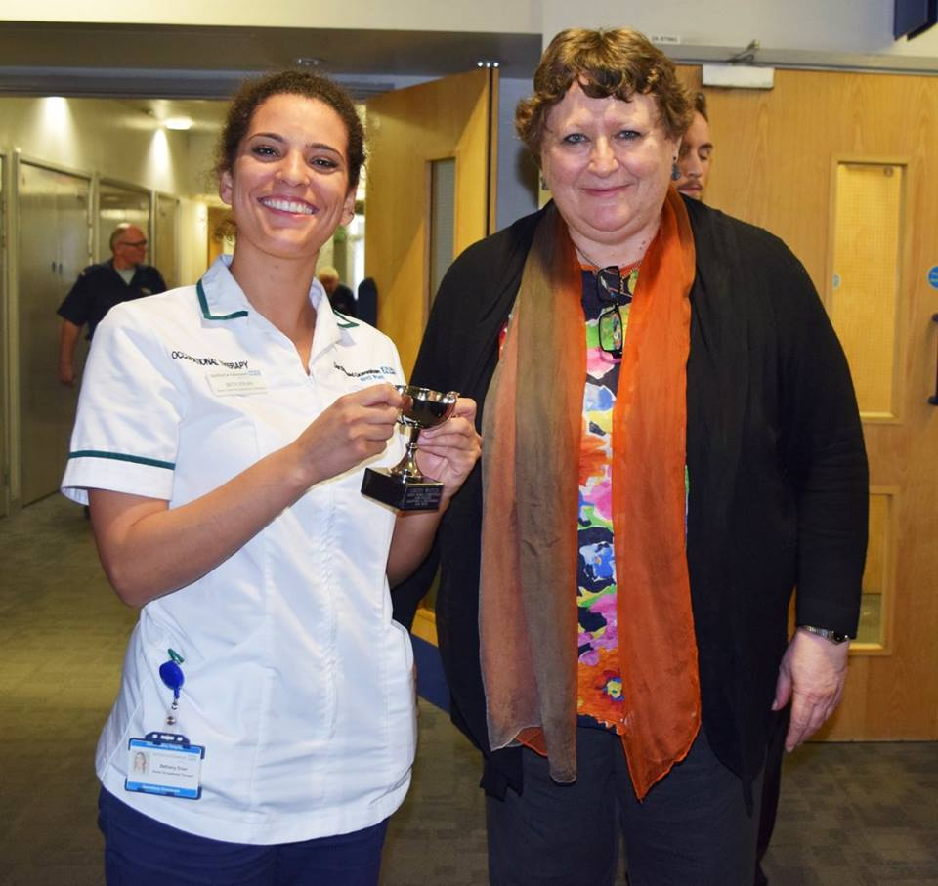






In practice…
Notes:
Example project: reducing unnecessary cannulation in the emergency department.
Many cannulae were inserted and not used or were used inappropriately (e.g. intravenous fluids or drugs used when the patient was able to drink and take oral medications). It was suspected that practice of inserting a cannula ‘routinely’ led to waste in terms of clinician time, waste of equipment required for cannulation, inappropriate use of intravenous fluids and medicines, unnecessary discomfort for patients.
At each cannulation the following kit is required: alcohol wipe, disposable tourniquet, cannula, cannula dressing, gauze, blood bottle adapter, 10ml saline ampoule, 10ml syringe, bionector and packaging. The total weight of the kit is 62g.
Results:
The total number of patients cannulated dropped from 143 in the first audit to 83 on re-audit., a 42% reduction.
The overall cost reductions, including purchasing and waste disposal, were £535.22 over one week, which would save £27,830 over one year.
The overall reduction in carbon footprint was 160 kgCO2e over one week, which would save 8,400 kgCO2e over one year.
Staff time
Patient experience
National initiatives, e.g.
Reducing environmental impact of inhalers – link into e.g. Right Care pathway
RCP – redesigning outpatients

Slide 34
In practice…
“The project has brought about real cultural and behavioural changes in the department. Now that we have participated … many clinicians are approaching me with ideas for other sustainability projects. We have a long list!”
Dr Cassie Worth, Emergency Medicine Consultant, Royal Devon & Exeter hospital
Notes:
Everyone can do 1. Some people might want to do 2.

Slide 35
In education…
“my students (working nurses) on the ICU nursing course are using the SusQI framework for their quality improvement project assignment. I’m marking essays now and adding in sustainability as a component of quality has enhanced the academic writing this year – it has also prompted the students to develop more interesting projects”
Dr Heather Baid, University of Brighton
Notes:
Everyone can do 1. Some people might want to do 2.

Slide 36
Teaching and mentoring for SusQI

Slide 37
Thinking sustainably within a QI project
Apply sustainability approach at the different stages of ANY project
  Embedding in materials and processes
Choose a project area that relates closely to sustainability, e.g.
  Prevention, patient empowerment, etc.
  Reducing pharmaceutical waste
  Reducing over-investigation / over-treatment
  Supporting highly motivated trainees
Notes:
Everyone can do 1. Some people might want to do 2.

Slide 38

Teaching SusQI – Barriers & Enablers?

Slide 39
Teaching SusQI – Barriers & Enablers?
 | Barriers | Enablers
Institutional
Inter-personal

Slide 40
SusQI open access learning resources
http://networks.sustainablehealthcare.org.uk/sus-qi-resources

Slide 41
http://networks.sustainablehealthcare.org.uk

Slide 42
http://sustainablehealthcare.org.uk/susqi
Thank you!
frances.mortimer@sustainablehealthcare.org.uk
@FrancesMortimer #SusQI

